Slide 1

VITA 49 VITA Radio Transport (VRT) A Spectrum Language for Software Defined Radios
9-Sept-2014
Presenter: Robert Normoyle, JHU/APL
Program Manager: Debra Hurt, JHU/APL
This work is funded by
Office of Naval Research Code 312

Slide 2
AGENDA
Overview of analysis effort for required attributes
Joint Open Architecture Spectrum Infrastructure (JOASI)
VITA 49 Overview and Enhancement Recommendations
VITA 49 Use Cases

Slide 3
Enhancing the
Open Architecture Process

Slide 4
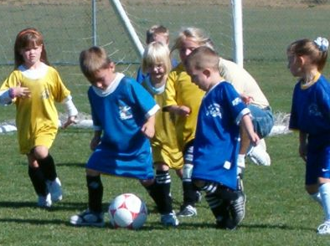
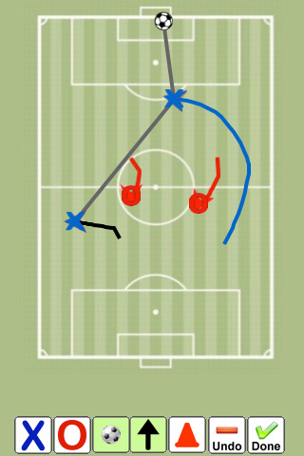
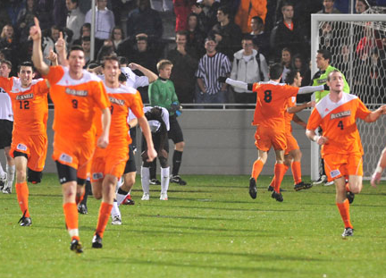
Interoperable Framework: Enabler for Real-Time Control of the EMS
Spectrum operations without a spectrum language
Spectrum language:
Policy (play) based
Real-time updates
Spectrum language:
key to victory in the EMS Domain
Each platform does what is best from its perspective
Notes:
Spectrum as a domain where we fight wars, platform independent

Slide 5
Enhancing DoD Open Architecture Approach
Typical DoD Open Architecture (OA) Approach
Interoperability
Open
architecture
standards
defined
Vendors
Analyze
government
requirements
Vendor
selects
“best suited”
OA
standard
Vendor
modifies OA
definition. Add
proprietary
elements
Govt. Acquisition
specify OA and
technical
requirements
OA standard
defined independent of government requirements
Often OA standards do not
fully meet requirements
ONR Approach
Industry
builds components and systems
Govt
Oversees
OA
Interoperability
Govt Team
Analyzes
Diversity of
App’s
& Req'ts
Govt Team
steer OA
Standards
Org’s
Govt Team
Develops
OA Core
technologies
Govt Team
demonstrates
OA profile
viability
Govt Team
develops
reference
designs
Govt Acq
Program
Specifies
proven
OA profile
Govt Matures
Key Tech
Component
Early government investment in OA process
yield OA standards to support future systems

Slide 6
What is an Architecture, Framework Infrastructure?
Architecture
Use specific HW & SW components
JTRS & SCA are examples
Framework
Standards that provide a wide diversity of capability
Applicable to many applications
Applicable to many architectures
A building blocks to specify architectures
Examples: V49, IEEE 1900, Pub 8
Infrastructure
A collection of orthogonal “Frameworks” integrated together to provide greater functionality than each standard by itself
Class
A sub-set of a standard(s) attribute used for a specific implementation/application - Narrowband HF may have different attributes than ultra wide band X-Band
Notes:
Describe differences between Architecture, Framework and Infrastructure

Slide 7
Spectrum Infrastructure
Joint
Open Architecture
Spectrum Infrastructure
Multi-Function EW
Requirements
EW Networking
( Iron Symphony)
Real-Time Data Transport (V49)
Cognitive Radio DSA
( IEEE 1900 DySpan)
Spectrum Management
( SSRF / Pub 8)
Joint Open Architecture Spectrum Infrastructure (JOASI)
An enabling technology for future radio architectures and spectrum applications:
Spectrum de-confliction
Improved situational awareness
Improved jamming effectiveness and capability
Dynamic Spectrum Access
Alternative Position Navigation and Timing
Framework for multi-function RF applications
Notes:
V49
V49 Legacy Standard
V49 Control and Exciter Packet Enhancements
V49 Recommendations for
Spectral, Configuration and Accuracy Packets
IEEE 1900
SSRF Overview
Iron Symphony
Existing capability
Notional concepts with JOASI components
Emersion into existing Spectrum Standards and their applications
Networking: Iron Symphony (CERDEC)
Data Transport: V49 (VITA and SIGINT community)
Spectrum Management Pubs 8 (DSO)
Cognitive Radio DySpan (IEEE)
Spectrum Mapping Radio Map (DARPA)
Red Hawk Development Environment (NSA)

Slide 8
JOASI Team Members and Observers
Team Members:
ACS (Telcordia)
ArgonST (Boeing)
BAE
DRS Signal Solutions
General Dynamics
ITT
JHU/APL
Northrup Grumman
Pentek
Shared Spectrum Company
URS
Other Participants at meeting:
CERDEC
DISA/DSO
ONR
OSD
MITRE
MIT
Other Participants
DARPA
NSA
Notes:
Briefly introduce each person who is attending
Unique Contribution
1
ACS (Telcordia)
ACS provides experience with US ARMY IRON SYMPHONY effort which provided networked EW capability to counter radio controlled IED. The lessons learned from this program will be leveraged into the framework for the spectrum infrastructure.
2
ArgonST
ArgonST provides expertise as a leading integrator of C4ISR and JTRS communication equipment. ArgonST developed the Sferic based equipment for navigation in a GPS denied environment. ArgonST will provide insight on data exchange requirements for navigation without GPS and will investigate using DYSPAN cognitive radio standards as a component of the spectrum infrastructure.
3
BAE
BAE provides expertise in the development of many communication and EW systems. In addition to providing a broad perspective of the framework for the spectrum infrastructure, BAE will study using the LINK 16 communication standard as a means to implement alternative PNT capability.
4
DRS Signal Solutions
DRS-SS led the development of the VRT/V49 spectrum standard and has implemented it on many of their radio devices. DRS-SS will provide the initial updates to VRT/V49 to define the control and the exciter packets. They provide expertise on the viability of this standard as component of the spectrum infrastructure and its application to distributed geolocation, such as TDOA
5
General Dynamics
General dynamics provide expertise with JTRS radios and distributed node synchronization in harsh RF environments including covert, anti-jam and high interference environments. They also bring expertise with cognitive radios. General dynamics will investigate the use of covert watermarking technology to convey spectrum awareness information and cognitive engine policies.
6
ITT
ITT provides over 20 years of expertise in JCREW architectures including CREW 2.1, MMBJ, EGON, JCREW 3.2 and JCREW 3.3. They are currently implementing the VRT/V49 standard into the latest JCREW architecture and thus will provide a unique perspective of the strengths, weaknesses, implementation issues and benefits to the warfighter.
7
Northrup Grumman
Northrup Grumman provides expertise in RF systems providing simultaneous multiple functions such as communications, EW, navigation and SIGINT. Northrup developed a JCREW 3.3 architecture, which will be used to analyze and report Spectrum Infrastructure implementation issues. They also provide a unique perspective of networked sensors providing intelligent networking jamming and comprehensive signal awareness
8
Pentek
Pentek is a leading provider of COTS open architecture software defined radios. They were a key contributor to the VRT/V49 standard. They will provide expertise on how to leverage the VRT/V49 standard to create context and exciter packets for networked EW applications. They provide a unique perspective of implementation issues on COTS hardware architectures
9
Shared Spectrum Corporation
SSC developed a dynamic spectrum access (DSA) engine that can be ported onto open architecture radios. Their cognitive radio ontology for spectrum management will be investigated to determine how to leverage and/or to integrate VRT/V49 attributes.
10
URS
Provides operational experience with JCREW devices, many of their employees were EW officers in Iraq and Afghanistan. Captain Hinkley (retired) of URS was responsible was responsible for setting up the first command post for countering IED’s in Iraq, Joint CREW Composite Squadron ONE. His team will leverage their operational experience in Baghdad to provide operational requirements and feedback on proposed spectrum infrastructure. Captain Hinkley also brings significant experience in interacting with Congress, Secretary of Defense, Secretary of Navy, Joint Chief of Staff and other government executives on JCREW efforts. His expertise will help communicate ensure that the appropriate government organizations are informed of our efforts, to get their guidance on our overall direction.

Slide 9
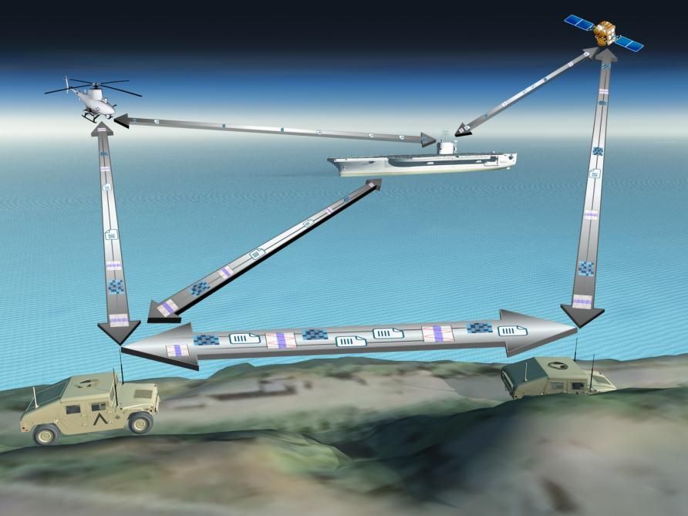
What is JOASI?
JOASI: An Enabler for Spectrum Interoperability

Slide 10
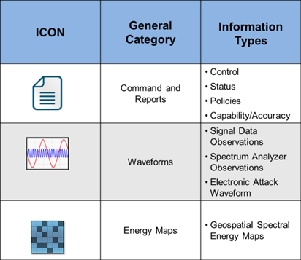
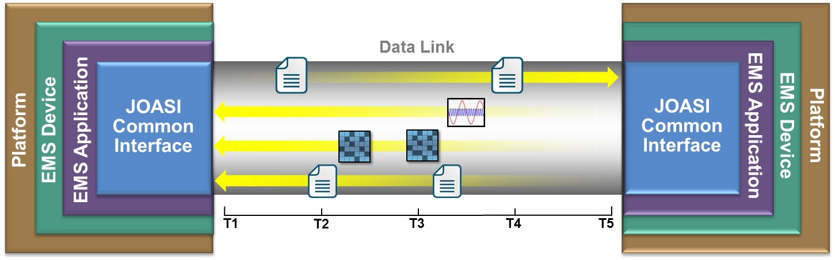
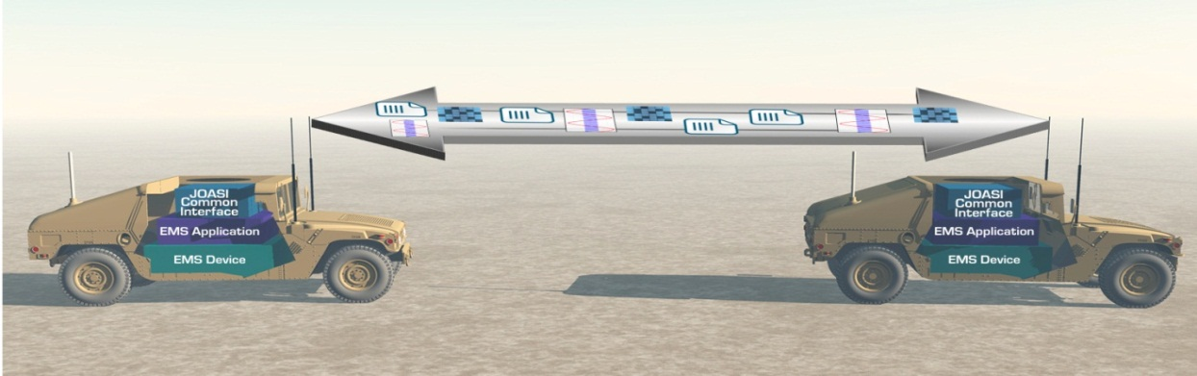
JOASI: Spectrum Standard Types

Slide 11
VITA 49 Overview
and
Enhancement Recommendations

Slide 12
Comparison of SCA to VITA
Software Communications Architecture (SCA)
SCA Characteristics
Application specific – Communications
Defined architecture
Defined components
VITA 49
Application independent
Does not define an architecture. It is a framework
Does not define components. It can be used to define interfaces between components
Could be leveraged as an application interface for SCA systems
Notes:
Robert
What it is not?
-- Presentation on a JTRS architecture…though it provides a missing component for JTRS radios
--JTRS defines an architecture that is specific in terms of:
-- Application…communication between two radios
-- SCA Components: OS, AEP, CORBA, CF, Domain Manager, Software Component Descriptor, waveforms and UML
AEP – Application Environment Profile
CF – Core Framework
CORBA – Common Object Request Broker Architecture

Slide 13
Overview of VITA 49.0
Transport Definition: Digitized Signal Data and Sensor Settings
Interoperability:
VRT provides a framework to define interoperable sensor architectures
Link independent
Sensor Synchronization/ Time Stamped Data:
Synchronization of multiple receivers in same/different platforms
Coherency between multiple receivers co-located in same platform provides synchronization/coherency of multiple sensors
Multiplexing:
Protocol to enable multi-channel signal data and context data to be sent over a single link
Signal Data:
Data packet definition and broad range of data types defined: 1-32 bits real, complex, alignment, event flag
Sensor Settings:
Provides a mechanism to convey sensor settings (context packets) relevant to geo-location processing
Geolocation:
A standard that provides location, inertial navigation and look angle of sensors
Notes:
The VITA 49.0 Standard effort is to:
Develop a link agnostic protocol format for sensor (RF) interfaces to DSP
Transmittal of digital IF (Intermediate Frequency) data streams
State of the sensor (frequency, gain, delay…)
Time stamping of data streams

Slide 14
VITA Protocol Elements
Signal Data Packets
Purpose: Convey digitized instantaneous frequency (IF) and RF signal data
Construct:
Packet Identifiers
Timestamp
Signal Data: 1-32 bits real, complex, floating point, vectors, event flags
Trailer
Context Packets
Purpose: Convey information on the SDR settings and spatial information
Construct:
Packet Identifiers
Timestamp
Context Fields: Frequency, bandwidth, power, gain, delays, sampling rate, overload, valid data, event flags
Notes:
PAUL

Slide 15
VITA 49 Generic Tuner/Receiver Block Diagram
Antenna(s)
. . .
Reference Point ID
Reference Point ID
Reference Point ID
Reference Point ID
Reference Point ID
I&Q Data
I&Q Data
RF Super-Heterodyne Tuner -Receiver
Analog to Digital Converter
(Digitizer)
Signal
Processing
& Filtering
IF Data
Packetizer
(VRT)
Over-Range
Count
Time Stamp
Adjustment
IF Tuning Freq
& Offset
Network
Interface
Reference Level
Bandwidth Setting
IF Context
Packetizer
(VRT)
AGC / MGC
Gain Settings
RF
Tuning Freq
& Offset
ADC Clock
Sample Rate
- IF Data
Payload
Format
1PPS /
10 MHz
Timing
Reference
Integer
& Fractional
Time-Stamp
Generation
- Context
Association
Lists
- State & Event Indicators
GPS
Receiver
Time Of Day
Clock
Calibration Time
Command
& Control
Processing
INS Location
ECEF Ephemeris
Relative Ephemeris
Ephemeris Reference ID
GPS
Location
Temperature
GPS ASCII
Device ID

Slide 16
Functional Description of VITA 49.0 & 49.1

Slide 17
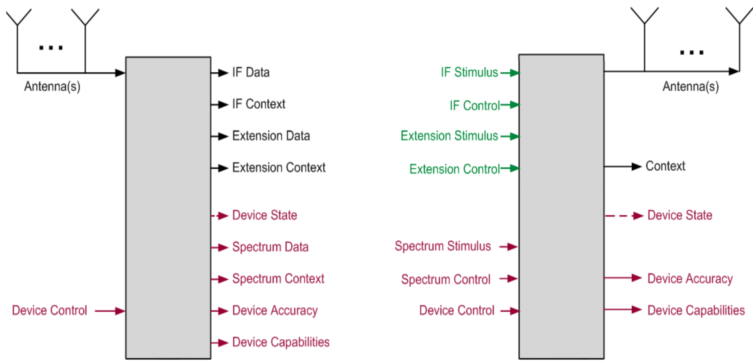
VITA 49 Packet Enhancements
SIGINT/
ES RF
Transmitter
VRT
Receiver
EA RF
Transmitter
VRT
Receiver
Existing VITA 49.0 Standard
IF Data & IF Context Packets
Associations / Pairing via Stream and Class ID’s
VITA 49.2 Draft
IF Stimulus Packet (TX waveform real or complex IF data samples)
IF Control Packet (RF TX signal control)
Additional JOASI Packet Types
Device Capabilities Packet
Adds device to Iron Symphony System Registry
Device Accuracy Packet
Parametric accuracy for associated Context Packet fields
Spectrum Data & Context Packets
Spectrum Stimulus & Control Packets

Slide 18
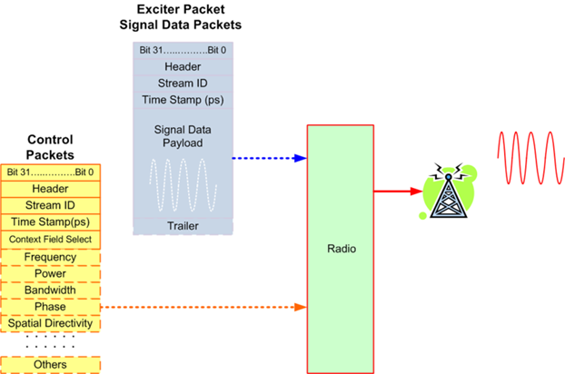
Proposed VITA 49.2
Device Control Packet
IF Stimulus (Exciter) Packet

Slide 19
New Packet Type: VITA Control Packet
Control Packet in development
Adds
Controller/Controlee Unique Identifier
Message ID
Control/Ack Indicator
Control Indicator
Control Fields
31 | 30 | 29 | 28 | 27 | 26 | 25 | 24 | 23 | 22 | 21 | 20 | 19 | 18 | 17 | 16 | 15 | 14 | 13 | 12 | 11 | 10 | 9 | 8 | 7 | 6 | 5 | 4 | 3 | 2 | 1 | 0
Header (1 Word, Mandatory)
Stream Identifier (1 Word, Optional)
Class Identifier (2 Words, Optional)
Integer-seconds Timestamp (1 Word, Optional)
Fractional-seconds Timestamp (2 Words, Optional)
Controller Unique Identifier (UUID) (4 Words, Mandatory)
Controlee Unique Identifier (UUID) (4 Words, Mandatory)
Message Identifier (2 Words, Mandatory)
Control/Acknowledge Indicator Field (1 Word, Mandatory)
Reserved, Must be 0 (1 Word, Mandatory)
Control Indicator Field (1 Word, Mandatory)
Control Fields (Present as indicated by the control indicators)

Slide 20
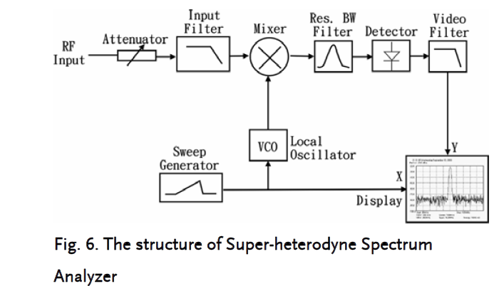
Spectrum Packet Enhancements
Spectral Type Information to convey via V49
Antenna pattern (Power vs. angle)
Filter characteristics (Power vs. Frequency)
Emission characteristics (Power vs. Frequency)
Spectrum Analyzer (Power vs. Frequency)
Spectrum Analyzer Attributes
Center Frequency
Span
Sweep rate
Resolution BW
Video BW
Detector type (peak, average…)
Threshold

Slide 21
Example Spectrum Survey Control Packet
Example Usage of VITA Control Packet for Controlling Spectrum Analyzer
Various Control Fields
Center Frequency
Span
Sweep Rate
Start/Stop Frequency
Resolution Bandwidth
Each field supports
44 bit integer portion
17.6 THz
20 bit fractional portion
0.95 µHz
Radix Point

Slide 22
VITA 49 Use Cases

Slide 23
Digital IF: Generic RF Receiver Example

Slide 24
Multi-Channel: VITA 49 Control Packets

Slide 25
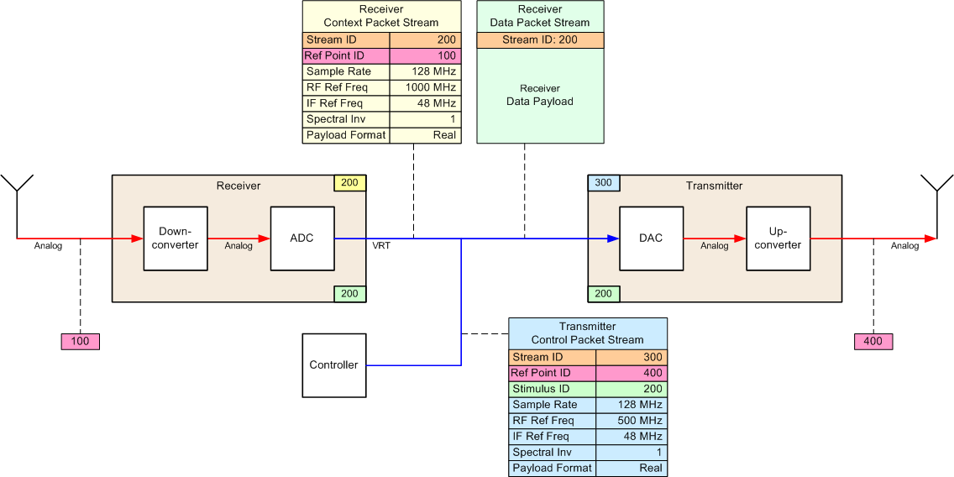
Repeater
Note: the ‘Stimulus ID’ field shown in these examples has been absorbed into the Dwell Control List (described later)

Slide 26
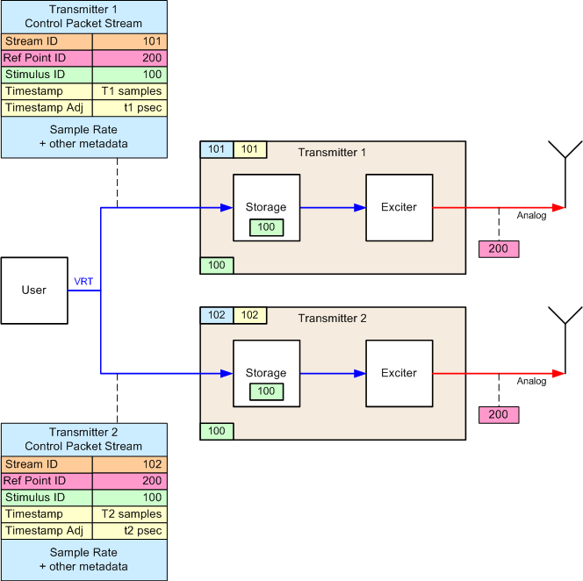
Beamforming
Use ‘Fractional Sample Delay’ instead of ‘Timestamp Adjustment’?
Notes:
Key benefit is that a radio architecture indendent language enables
Interoperability across multiple radio types
Preservation of SW investment as radios are upgraded
Time stamp control of beam-form signal could provide a simple interface for long-base-line beam formers

Slide 27
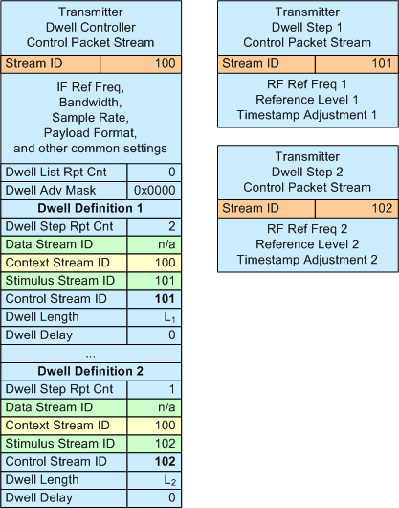
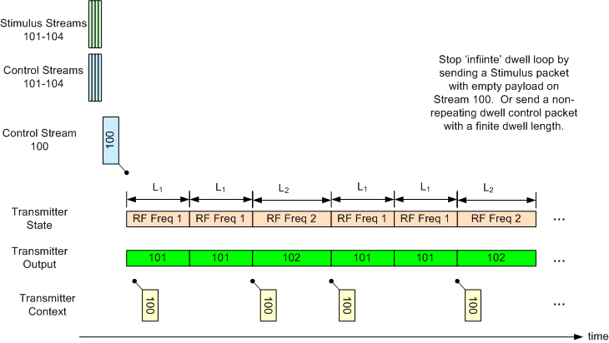
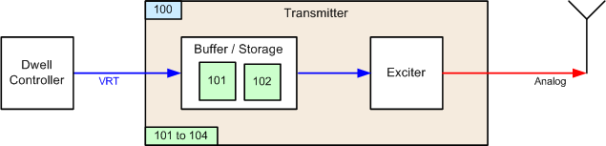
Auto TX Dwell

Slide 28
Conclusion
VITA 49 Enhances SDR system architectures
Eliminates stove-pipe architectures
Enhances interoperability between components
Standard for multi-channel phase coherent architectures
Transport for multi-function SDR architectures
2014 Enhancements
Control Packet
Exciter Packet
Spectrum Packet
Notes:
Robert

